Slide 1
Corona Travel
Full design

Slide 2
Product description
Our goal is to allow users to travel online from home via any device of their liking. They'll start by opening an app or a link and choosing a desired destination. After choosing a location, users can choose to view destination in 3D, look at some 3D photos or videos or learn some facts about the place.
Team: Sofya Donskaya, system analyst; Elena Karelina, backend developer; Danil Kireev, frontend developer; Artem Filimonov, backend developer + API integrator
Repo: https://github.com/randomunrandom/corona_travel
Report: https://docs.google.com/presentation/d/1WcBw-mAGlyChm8_RNxzQNxS8TR9Rn6DQTB6B_dtDxVA/edit?usp=sharing

Slide 3
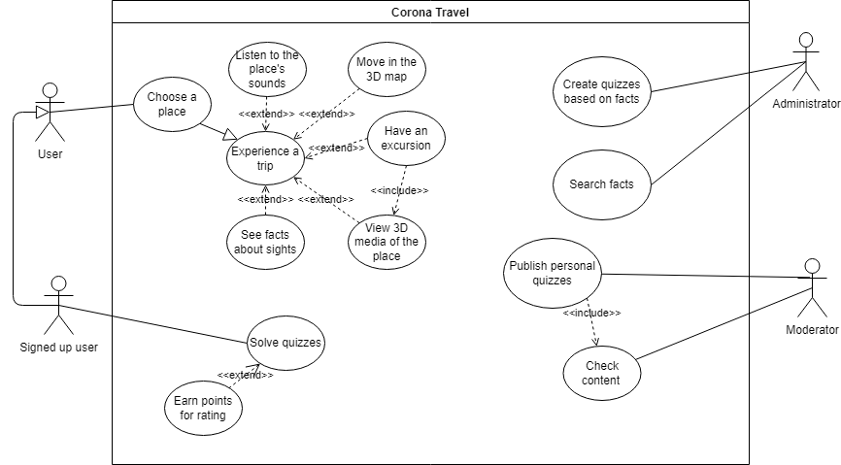
Use case diagram
Scenarios: https://github.com/randomunrandom/corona_travel/wiki/Scenarios

Slide 4
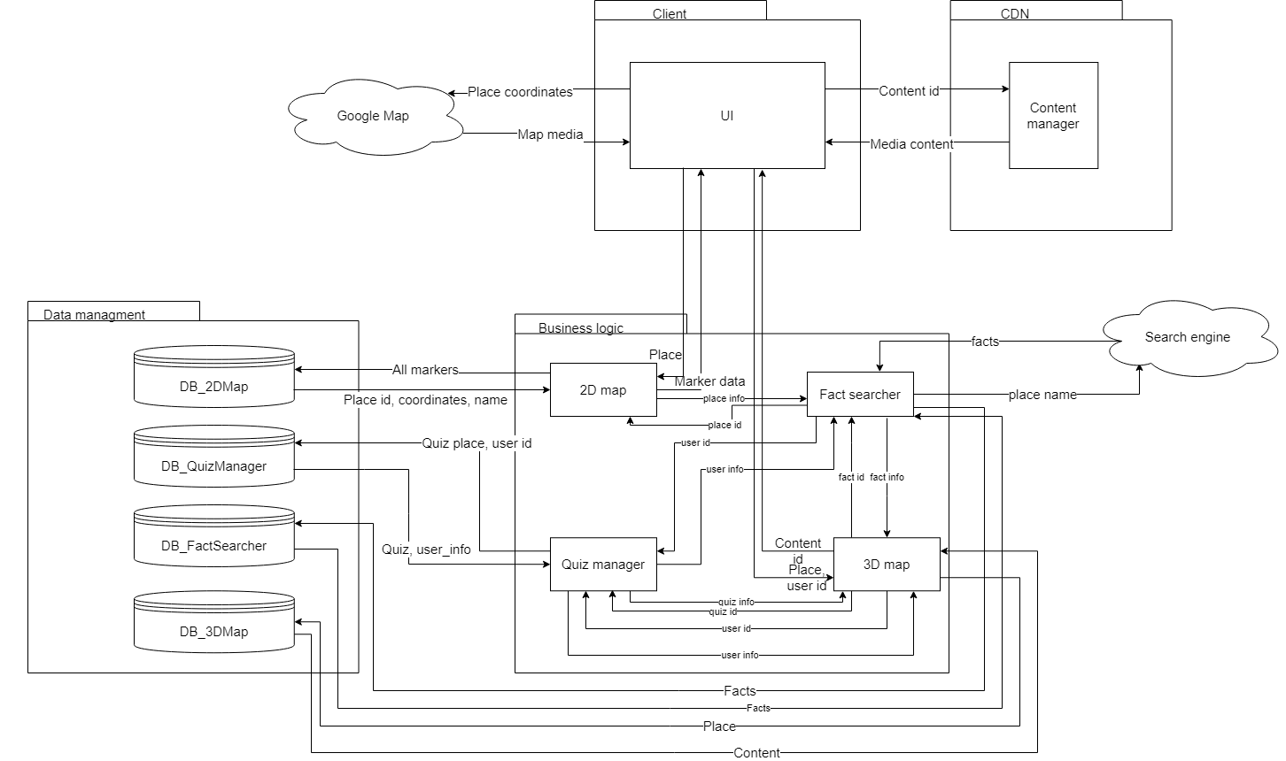
System architecture
Most important principles within our architecture:
Simplicity
Separation of concerns
Don't Repeat Yourself (DRY)
Easy to extend
Weak bounds

Slide 5
Solution stack
Testing tools
pytest, mongomock
Operations
App initializer: none
Code build – No explicit build, project info with pyproject.toml
CI/CD pipeline – GitHub Actions
Delivery method – Docker
Monitoring – Grafana
Implementation
API definition: OpenAPI
Connection server for API: python uvicorn
App framework: FastAPI (ASGI)
Serialization/state format: json
Database: MongoDB (NoSQL, Document-oriented)
Notes:
Find as example implementation of a microservices application in the programming language chosen. Specify one value for each option below

Slide 6
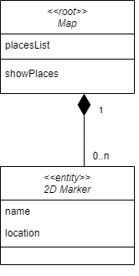
Logical data model Class diagram for 2D Map Service

Slide 7
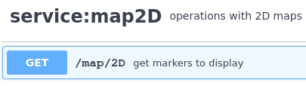
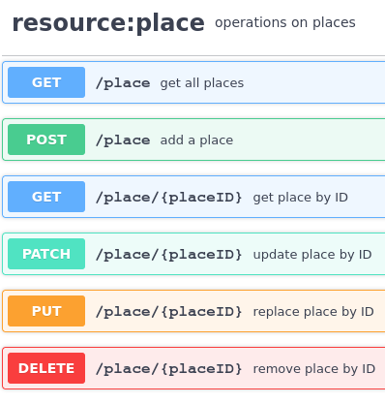
API summary <Map 2D>
User Scenario 1: User opens 2D map to see places that he/she can visit, user selects a place on a map and start his/her experience
On a page map2D - GET /map/2D - get data for markers on 2D map, calls GET /place - (Choose destination) On a page edit_map/2D - GET /place - get all of places that will be displayed on map On a page edit_map/2D - POST /place - add data to 2D map On a page edit_map/2D - PUT /place/{placeID} - modify marker on 2D map On a page edit_map/2D - DELETE /place/{placeID} - remove marker from 2D map

Slide 8
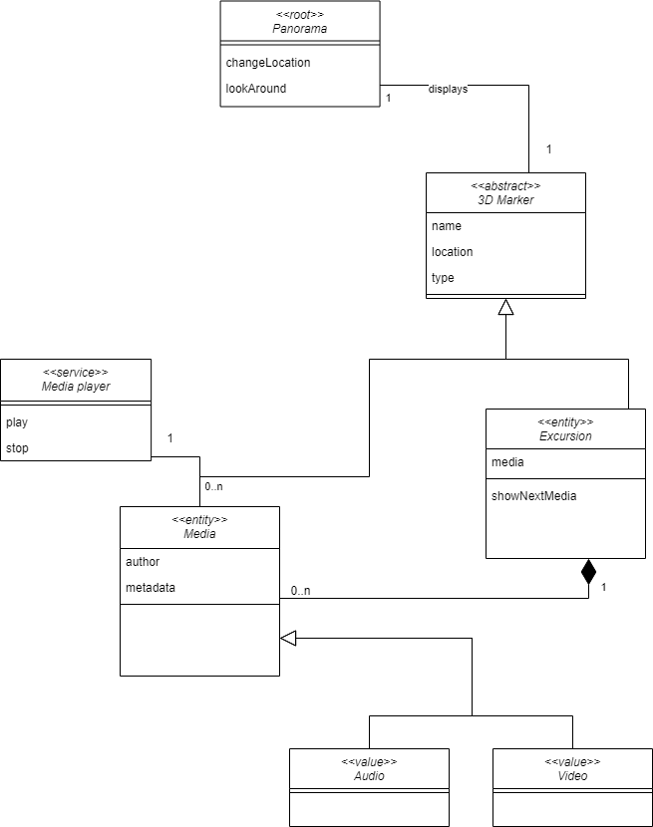
Logical data model Class diagram for 3D Map Service

Slide 9
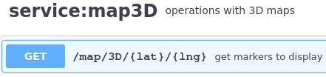
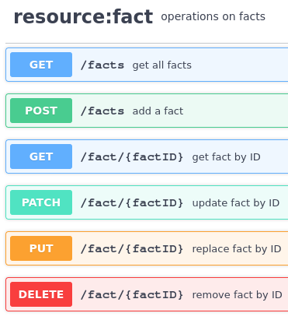
API summary <Map 3D>
Scenario 2: User sees 3D Media, comes across some 3D markers with the info of a place, clicks on any point of the area. The map shows the views of the selected place in map.
On a page map3D - GET /map/3D - get data for markers on 3D map, calls GET /facts, GET /quizes and GET /media and filters out far away markers - (Move in the 3D map) On a page map3D -GET /media/{media_id} - get media to display - (view 3D media of the place) On a page map3D - GET /fact/{fact_id} -get fact to display - (see facts about sights) On a page edit_map/3D - POST /facts - add a new fact On a page edit_map/3D - PUT /fact/{fact_id} - update a fact by id

Slide 10
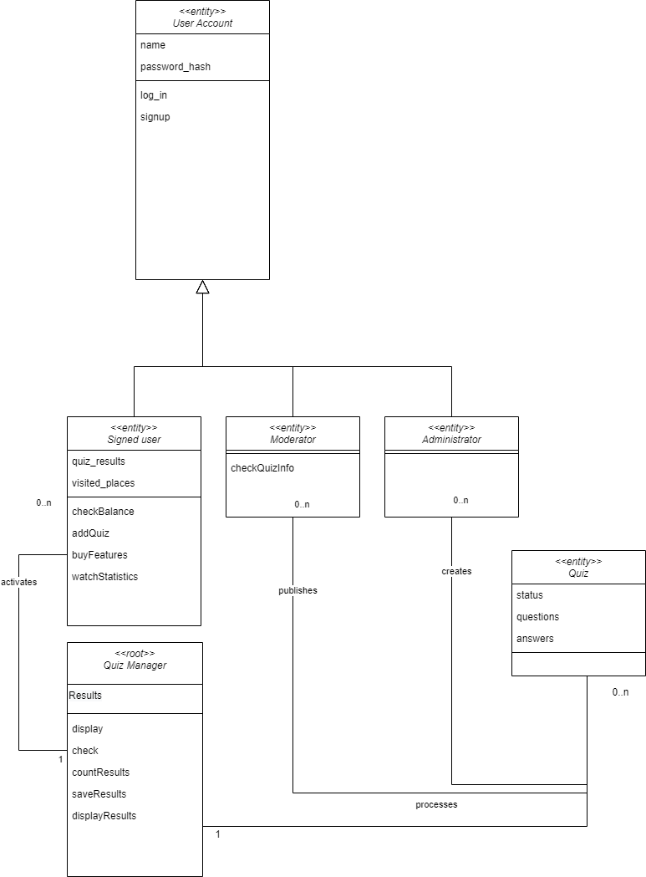
Logical data model Class diagram for Quiz Manager

Slide 11
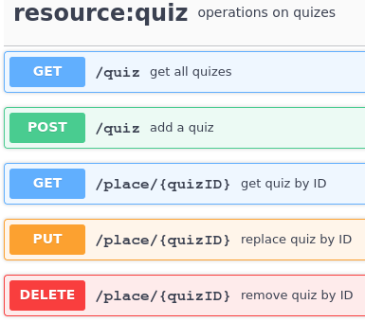
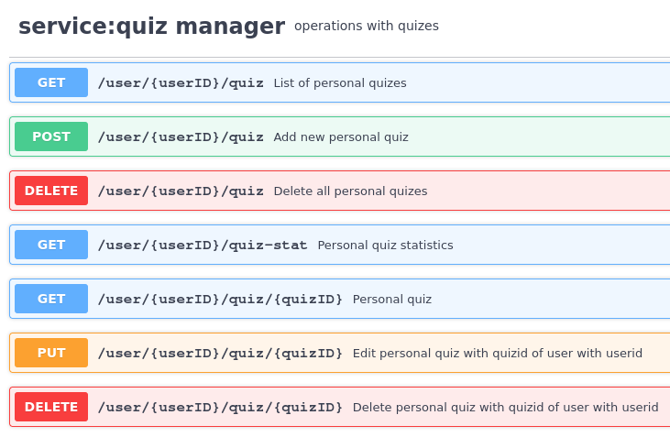
API summary <Quiz Manager>
Scenario 5: User accepts the offer to have a quiz. The system shows the list of questions for the quiz.
On a page quiz - GET /quiz - show available quizzes - (solve quizzes) On a page /user/quiz - GET /user/{user_id}/quiz - show personal quizzes On a page /user/quiz - POST /user/{user_id}/quiz - create a new quiz On a page /user/quiz - PUT /user/{user_id}/quiz - update a page On a page /user/quiz - DELETE /user/{user_id}/quiz - remove personal quiz

Slide 12
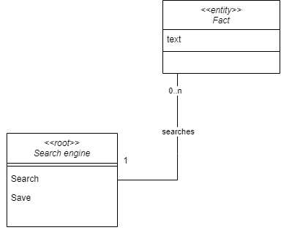
Logical data model Class diagram for Fact Searcher

Slide 13
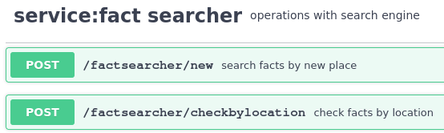
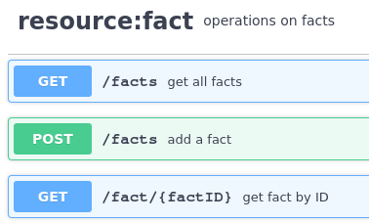
API summary <Fact searcher>
Scenario 7: Administrator decides to add new place to the app. He adds place to the database and in order to find facts for new place he requests fact searcher via API. Facts are saved in database with relevant attributes.
On a page fact_searcher - POST /factsearcher/new - get new facts On a page fact_searcher - POST /factsearcher/checkbylocation - check that facts with the same location doesn’t exists On a page fact_searcher - GET /facts - get list of facts to check for duplicates On a page fact_searcher - POST /facts - add a new fact On a page fact_searcher - GET /fact/{factID} - get info about the fact to check for duplicates

Slide 14
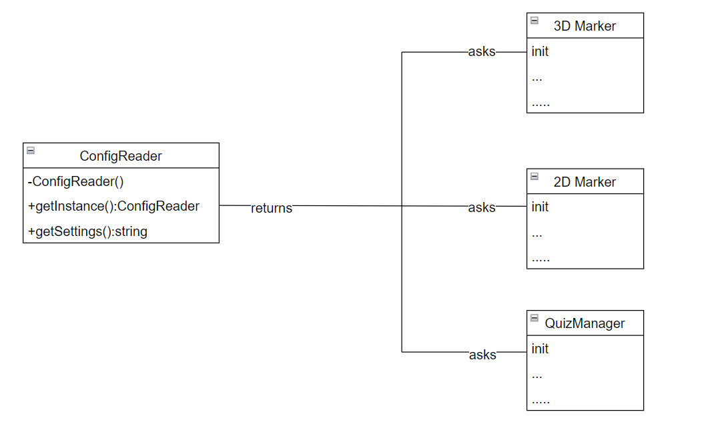
Design case <1> (UML2)
Problem: don’t read settings file multiple times because using file settings is slow
Solution: the class responsible for reading file with settings should be created only once and read file at creation. Use singleton

Slide 15
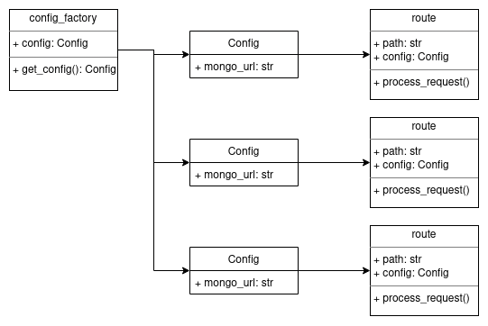
Design case <2>
Problem: get settings in routes as dependency to process routes asynchronously
Solution: use factory to create the same config for every route
Notes:
Another design case we want to show revolves around settings in our asynchronous app. The problem is that we need some king of unified settings object, which will store all of the configs: log level, database url and so on. But, since our app is asynchronous, we need to think about threading and how we’ll test this. So, to solve this, we used dependency injection of our Framework, which allows us to insert functions to run before our routes. This function returns settings for routes and can be overwritten for testing. Another possible solution is global object of settings, which could interfere with threading, making routes slow down to read the same object from memory, and would add problems with overriding in testing.

Slide 16
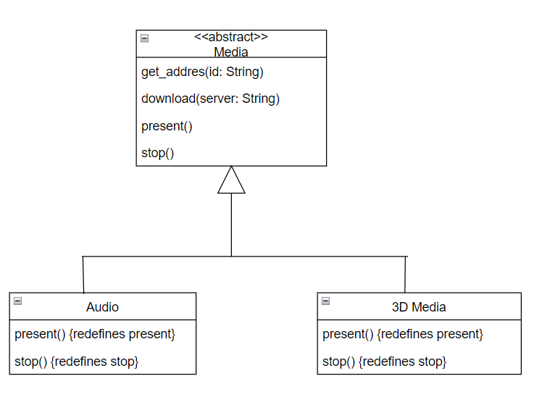
Design case <3> (UML2)
Problem: range of similar actions (but not all) while working with different types of media.
Similar actions: get address by id, download
Different actions: present (display or play), stop presenting
Solution: use template method

Slide 17
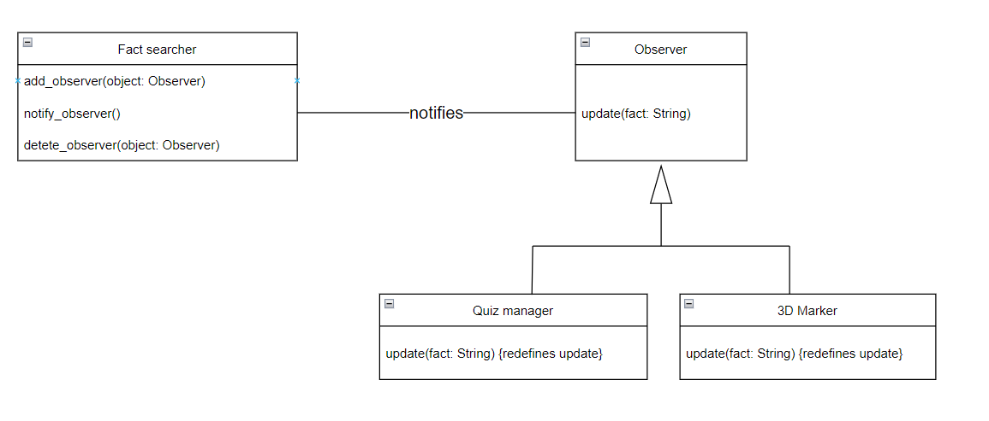
Design case <4> (UML2)
Problem: several classes (quiz, 2D markers) use facts and need to be notified when a new fact is added by fact searcher
Solution: use observer

Slide 18
Design complexity
Chidamber-Kemerer suite (3D map service)
 | WMC | DIT | NOC | CBO
User account | 2 | 0 | 3 | 3
Panorama | 3 | 0 | 0 | 2
3D Marker | 1 | 0 | 4 | 2
Media player | 2 | 0 | 0 | 1
Excursion | 1 | 1 | 0 | 2
Fact | 0 | 1 | 0 | 1
Media | 0 | 1 | 2 | 1
Audio, Video | 0 | 2 | 0 | 0

Slide 19
Design complexity
Service dependency metrics:
 | Coupling |  |  |  | Cohesion
 | SIY | AIS | ADS | ACS | SIDC | SIUC | TSIC
2D map | 0 | 0 | 0 | 0 | 1 | 6/10 | 8/10
3D map | 0 | 0 | 0 | 0 | 1 | 8/10 | 9/10
Quiz manager | 0 | 0 | 1 | 0 | 1 | 11/15 | 13/15
Fact searcher | 0 | 0 | 0 | 0 | 1 | 1 | 1

Slide 20
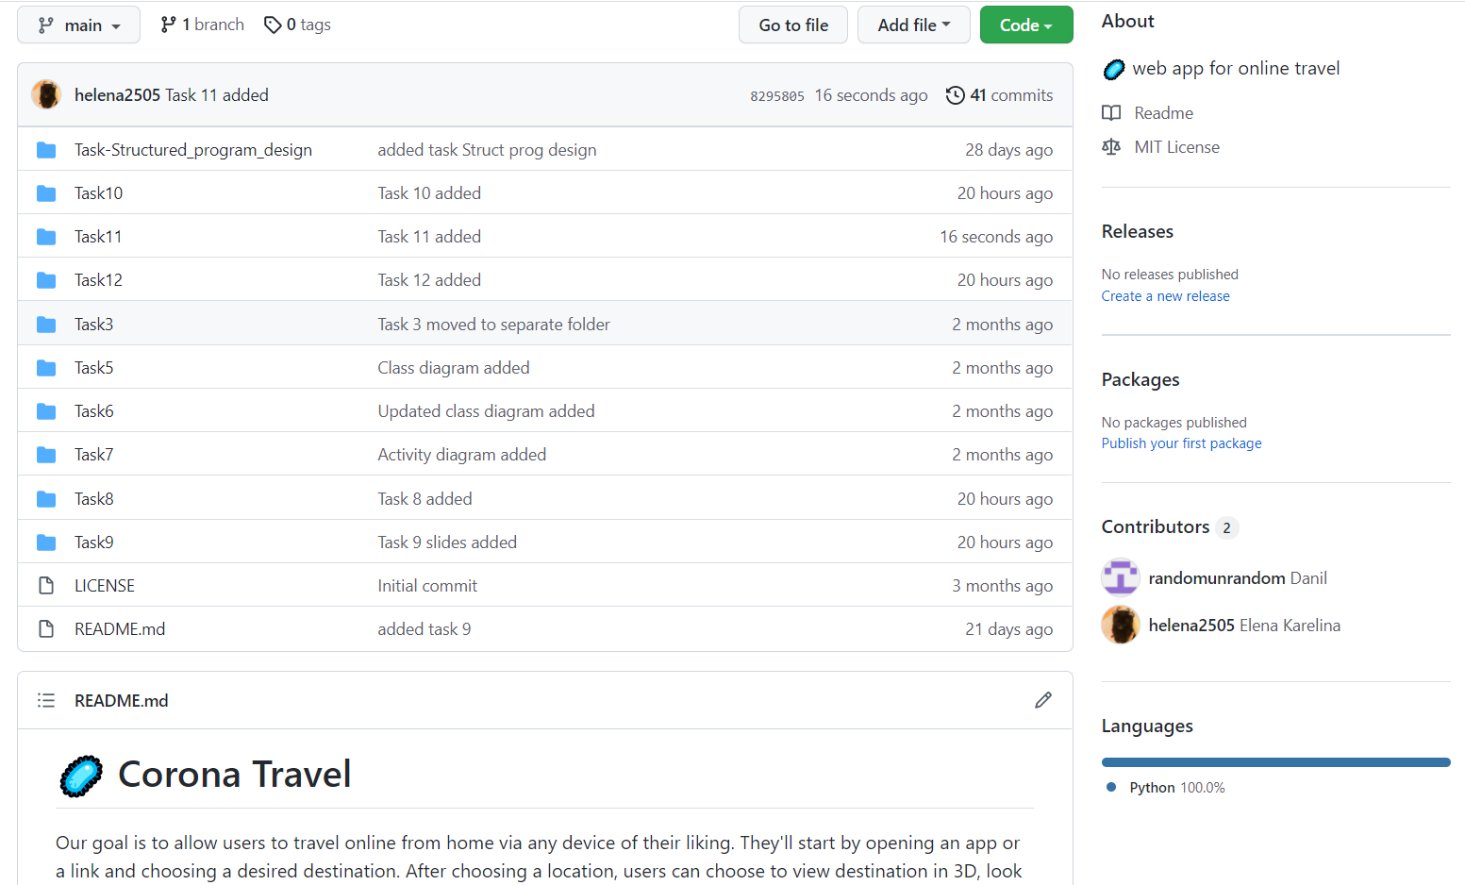
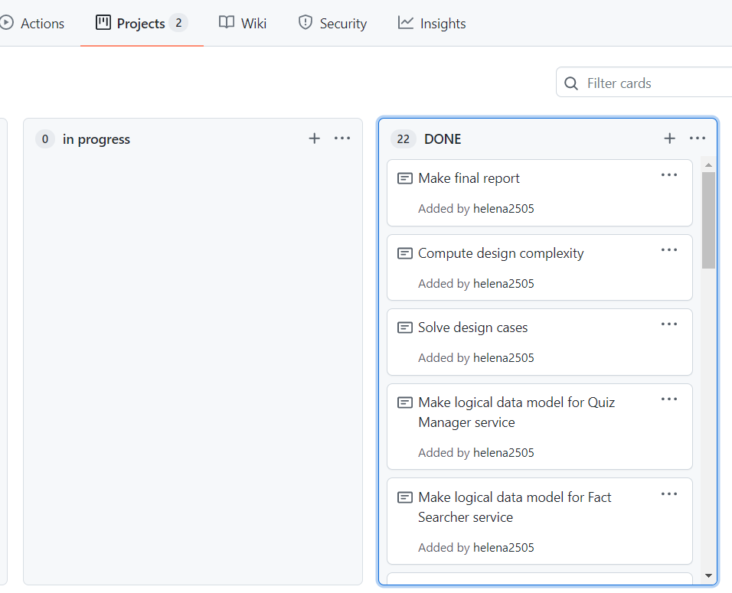
Repository structure

Slide 21
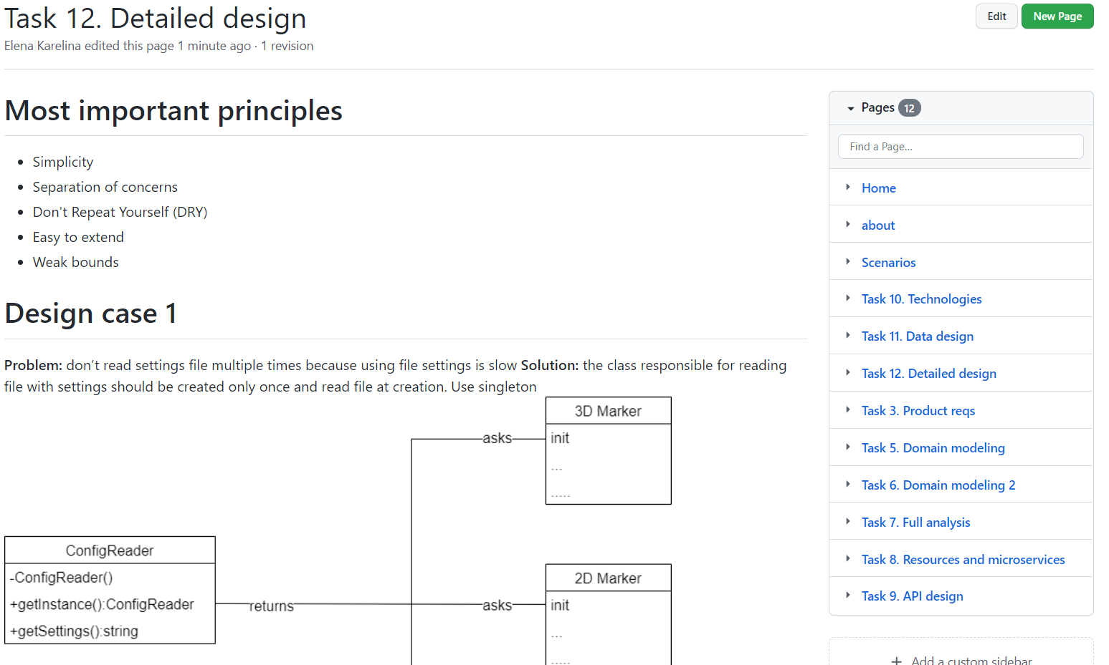
Repository structure

Slide 22
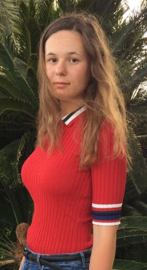


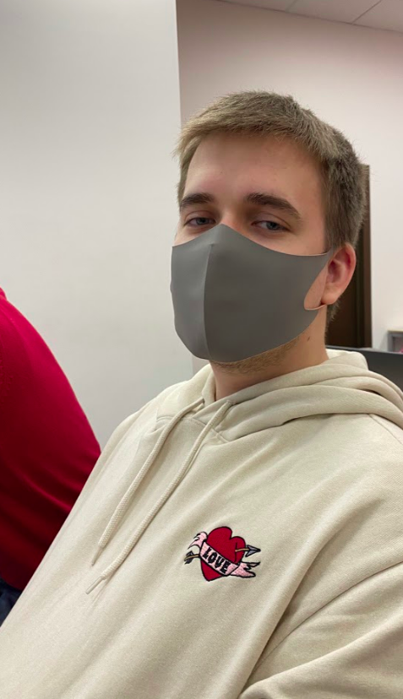
Team and roles
Elena Karelina, @e_karelina,
Quiz Manager + repo + design cases + design complexity
Sofya Donskaya, @do_nsk,
2D Map + diagrams modification + design cases + design complexity
Artem Filimonov, @pe4enko322,
Fact searcher + system architecture + design cases + design complexity
Danil Kireev, @unrndm,
3D Map + solution stack + design cases + design complexity

